Slide 1
Basic MATLAB Programming Course

Slide 2
What we will learn in this session
The basic MATLAB interface.
Basic commands.
Declaring & manipulating variables.
Plotting graphs.
Conditional Operators.
Functions.

Slide 3
Basic MATLAB Interface

Slide 4
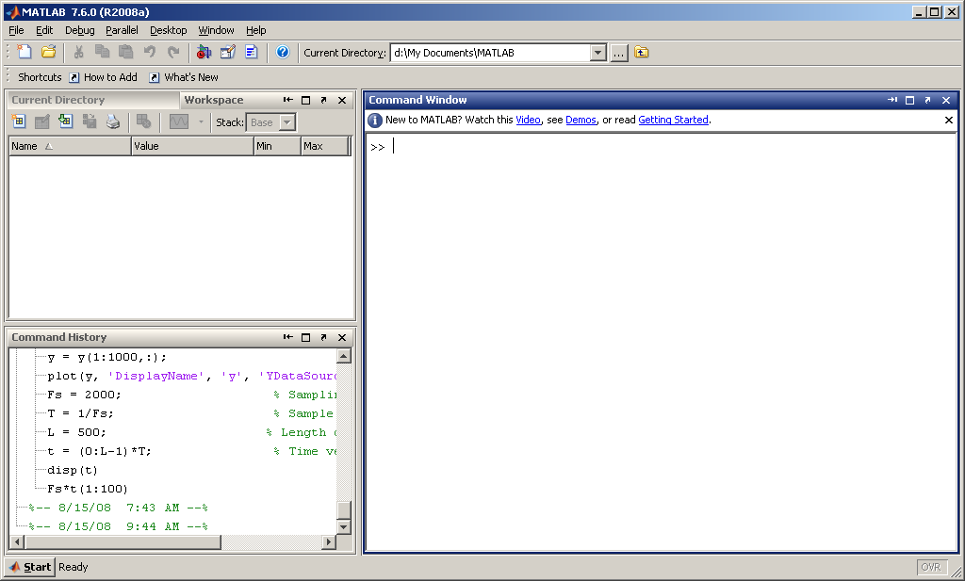

Slide 5
Command window: Type your
instructions here and press
ENTER to execute them.

Slide 6
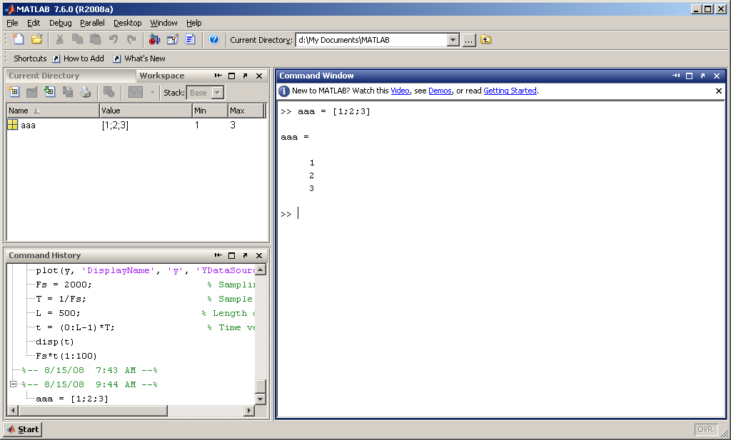
Example: Declare a column matrix with
values 1,2 and 3.

Slide 7
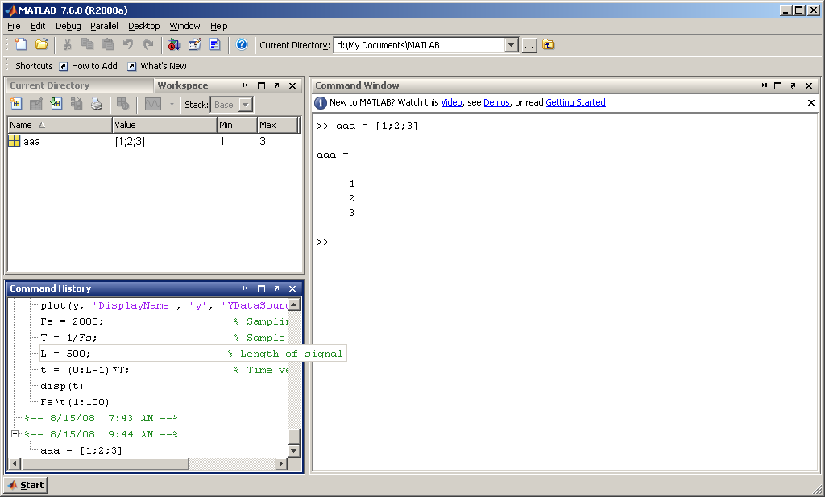
Command history: a list of instructions
executed by MATLAB is shown here.

Slide 8
Workspace: shows a list of
variables created by MATLAB.
As you can see, the value of ‘aaa’
is shown.

Slide 9
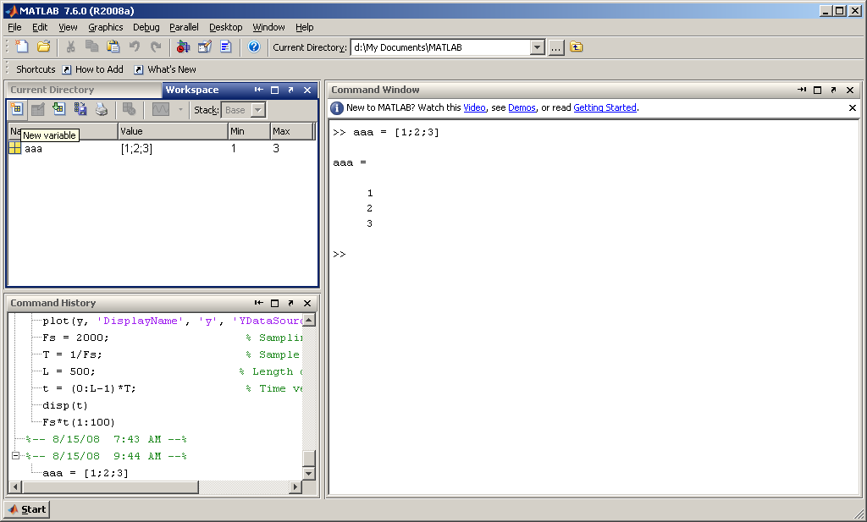
Another way to create a variable
Is to press this button.

Slide 10
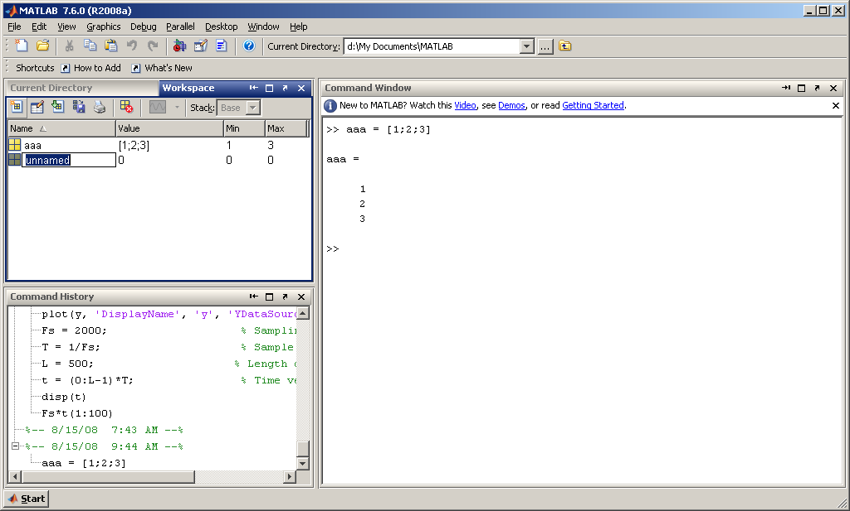
MATLAB will prompt you to enter
the variable name.

Slide 11
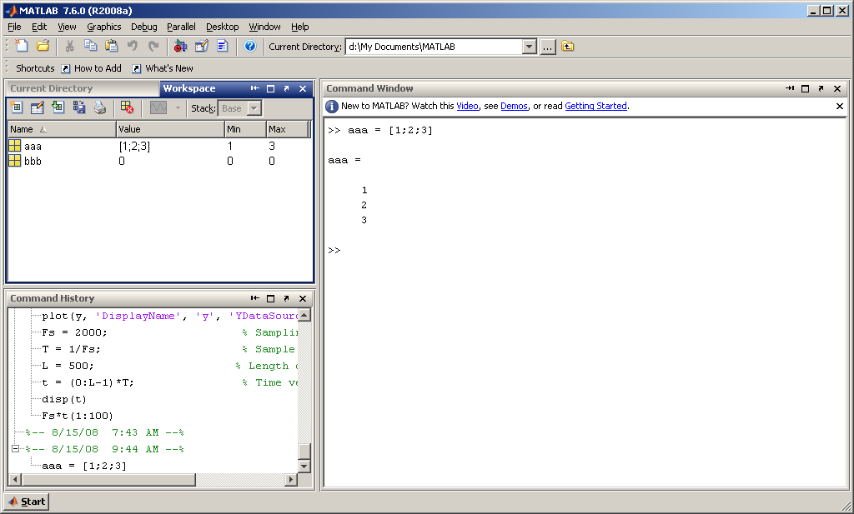
As you can see, the variable
name has been changed to bbb.

Slide 12
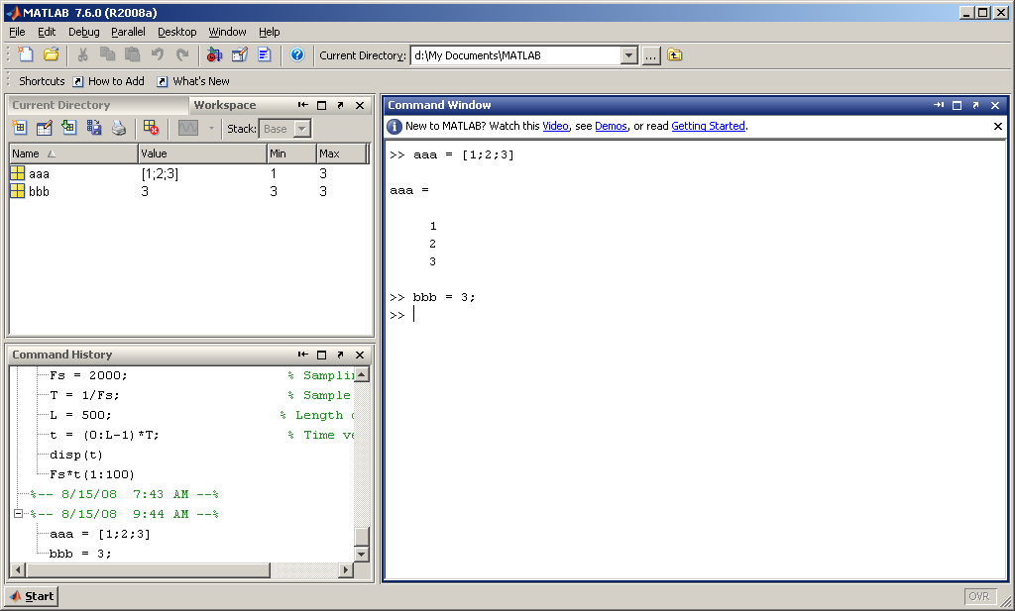
2) Or by double clicking on bbb.
To assign a value to bbb, you can do it in
two ways: 1) Using the command window.

Slide 13
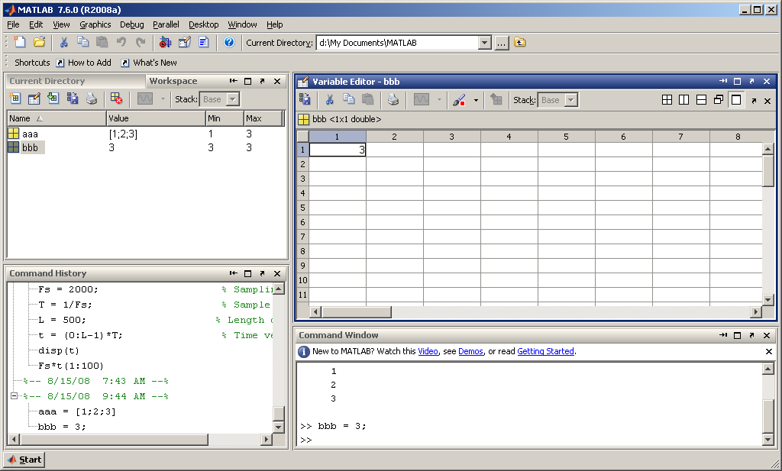
When you click on bbb, the variable
editor window appears. You can type
in new values into bbb by filling in the
cells.

Slide 14
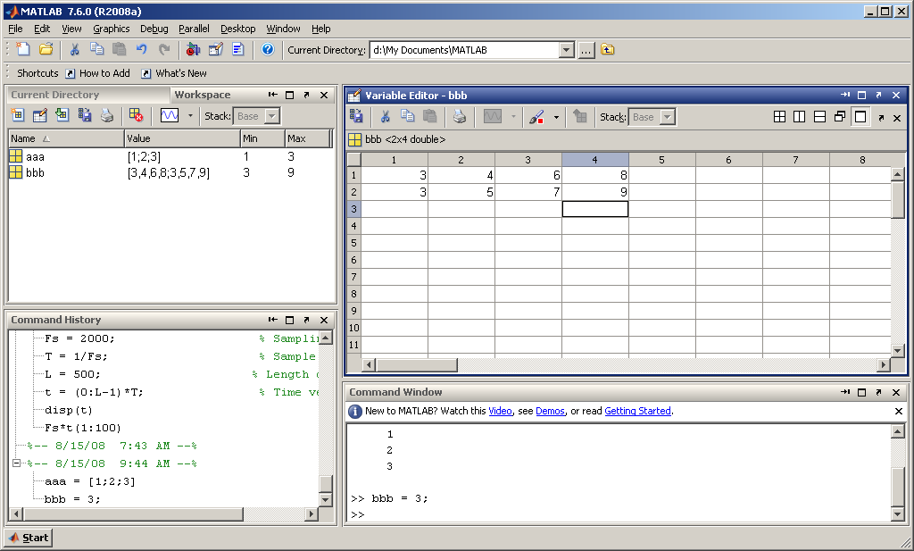
An example is shown here.
Try and do it yourself.

Slide 15
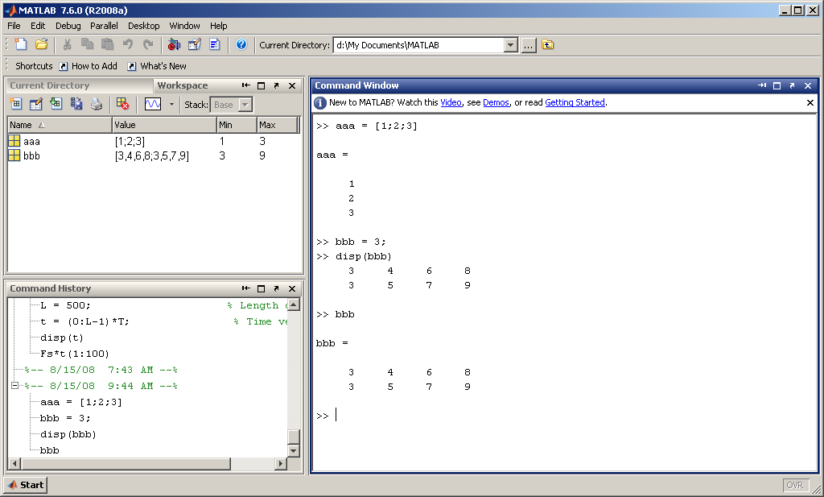
To display variables at the console,
you can type the variable name,
or you can type disp(variable_name).

Slide 16
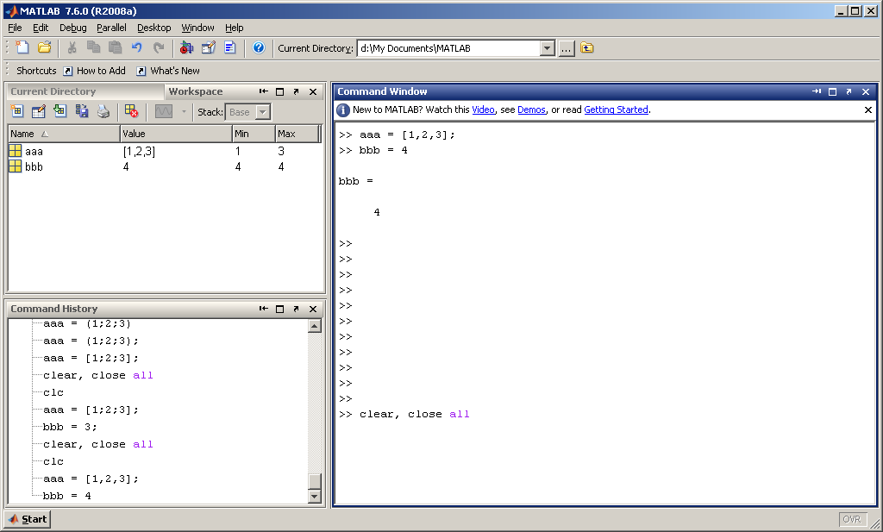
To clear all variables from
memory and close all
figures, use the
clear, close all command.

Slide 17
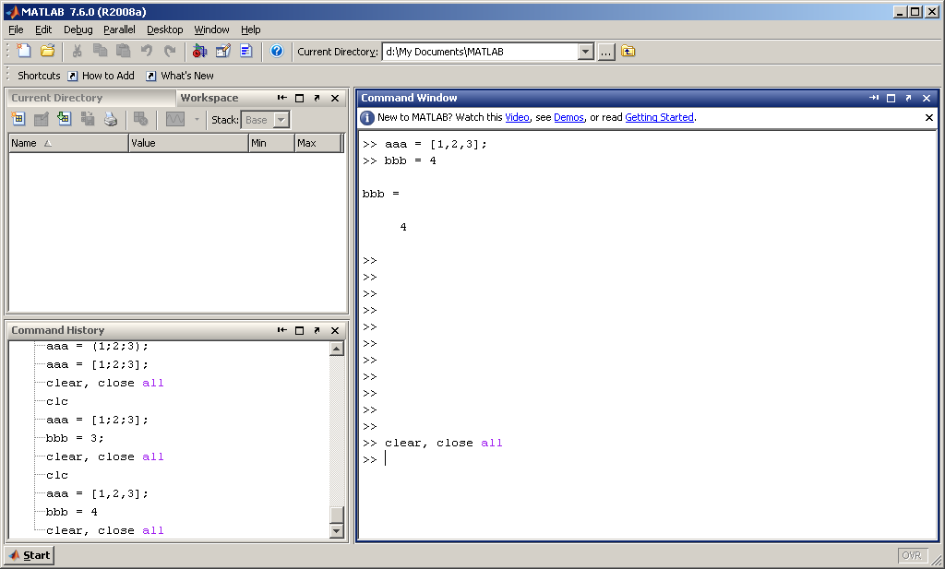
As you can see, all workspace
variables are deleted when
you execute this command.

Slide 18

To clear the command window,
use the clc (clear console) command.

Slide 19
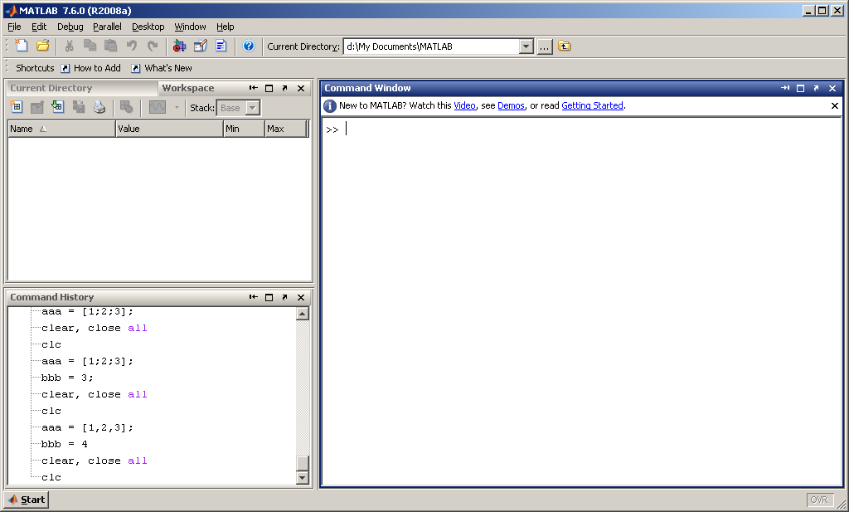
As you can see, all console
entries are deleted when
you execute this command.

Slide 20
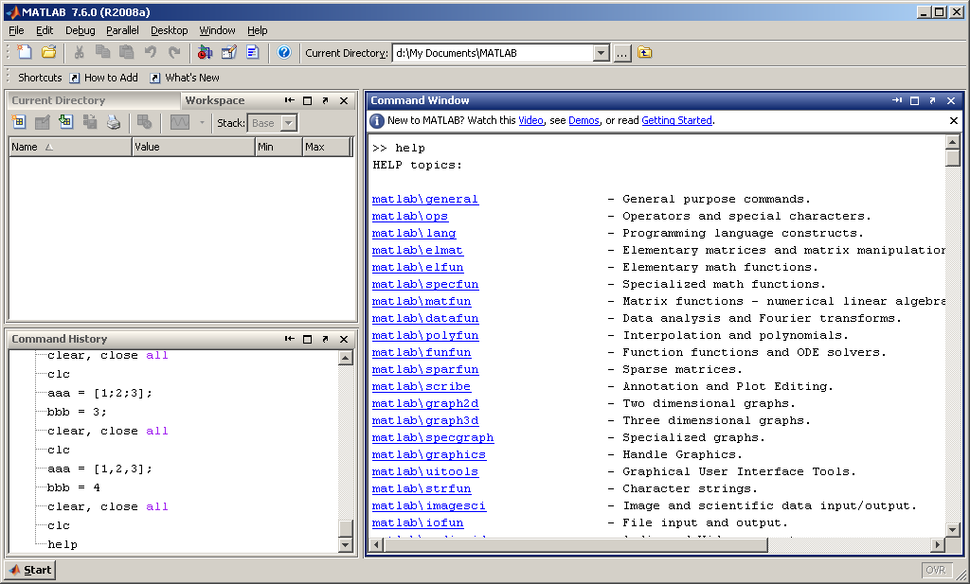
If you want to see help,
you can type help at the
command window.

Slide 21
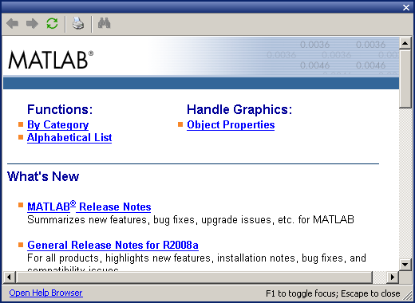
Or you can press F1
to display the help
window. Click on
Open Help Browser
to search for a
specific function.

Slide 22
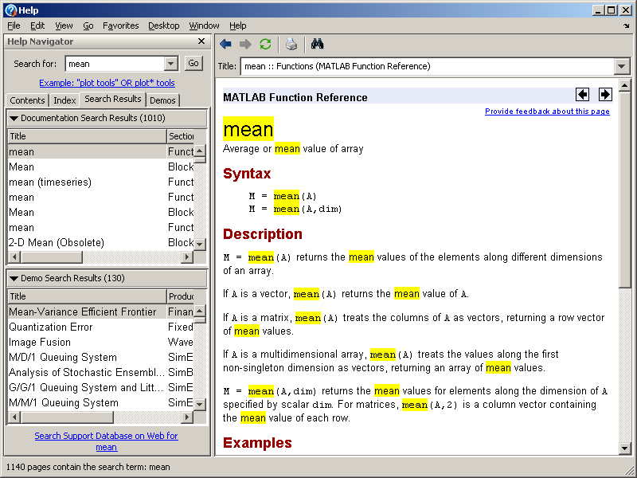
Example: search for
function mean

Slide 23

To create an m-file, 1) type edit at
the command window, or
2) Press this button.

Slide 24
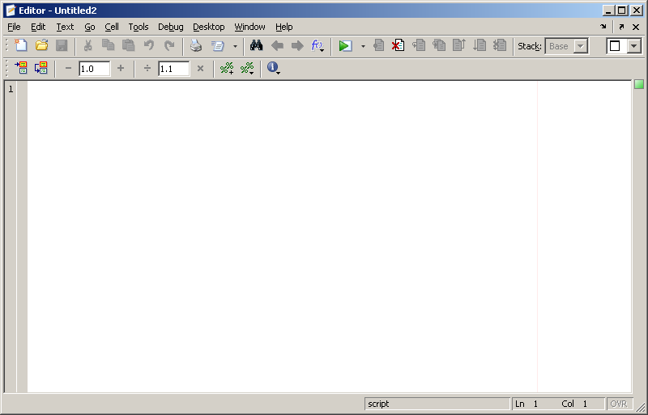
The previous command will
display the editor window.
The editor creates an m-file
that can be used to write
your MATLAB programs.

Slide 25
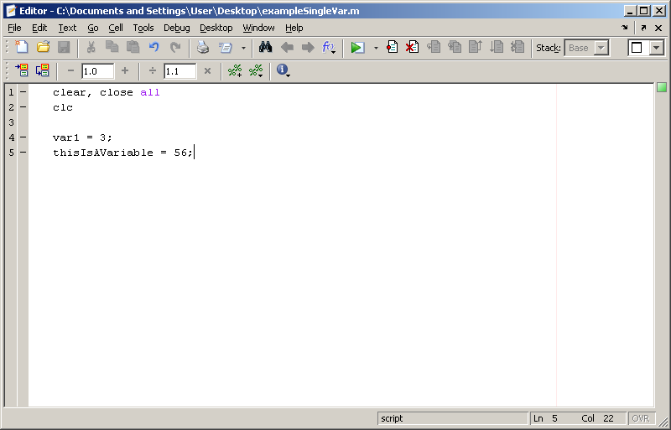
To execute a program, press
the RUN button.

Slide 26
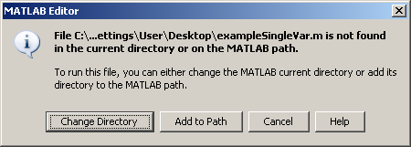
This window will appear. Press the
Change Directory button.

Slide 27
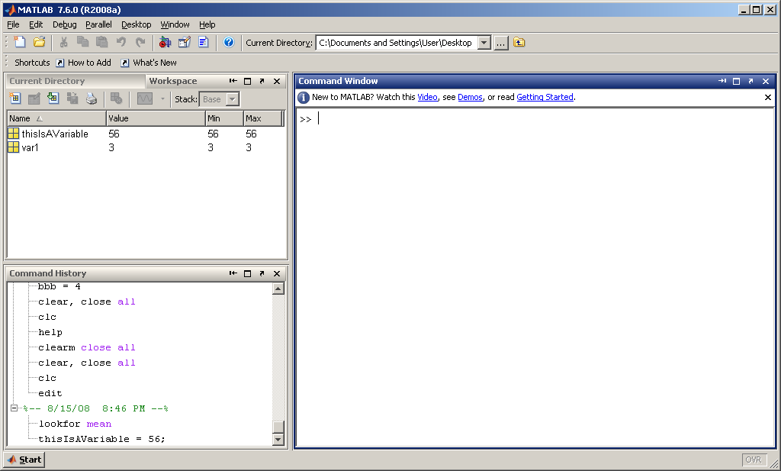
You can see that the program has
created two new variables in the
Workspace.

Slide 28
MATLAB BASICS
Summary
help command → Online help
lookfor keyword → Lists related commands
which → Version and location info
clear → Clears the workspace
clc → Clears the command window
diary filename → Sends output to file
diary on/off → Turns diary on/off
who, whos → Lists content of the workspace
more on/off → Enables/disables paged output
Ctrl+c → Aborts operation
… → Continuation
% → Comments

Slide 29
Basic Commands

Slide 30
MATLAB BASICS
Variables and Arrays
Array: A collection of data values organized into rows and columns, and known by a single name.
Row 1
Row 2
Row 3
arr(3,2)
Row 4
Col 1
Col 2
Col 3
Col 4
Col 5

Slide 31
MATLAB BASICS
Arrays
The fundamental unit of data in MATLAB
Scalars are also treated as arrays by MATLAB (1 row and 1 column).
Row and column indices of an array start from 1.
Arrays can be classified as vectors and matrices.

Slide 32
MATLAB BASICS
Vector: Array with one dimension
Matrix: Array with more than one dimension
Size of an array is specified by the number of rows and the number of columns, with the number of rows mentioned first (For example: n x m array).
Total number of elements in an array is the product of the number of rows and the number of columns.

Slide 33
MATLAB BASICS
1 2
3 4
5 6
a=
3x2 matrix → 6 elements
b=[1 2 3 4]
1x4 array → 4 elements, row vector
1
3
5
c=
3x1 array → 3 elements, column vector
a(2,1)=3 b(3)=3 c(2)=3
Row #
Column #

Slide 34
Declaring Single Variables
To declare single variables, type in a variable name and type in its value.
MATLAB will decide on the data type automatically, so you don’t have to declare its data type.
Example:
  var1 = 3;
  thisIsAVariable = 56;

Slide 35
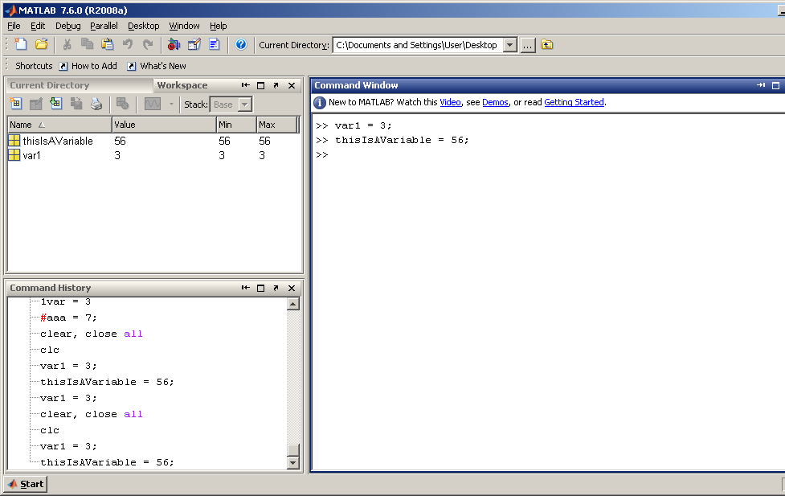

Slide 36
Declaring Single Variables
Variables cannot have numbers or symbols in front of them.
Example of illegal variable names:
  1var
  #aaa

Slide 37
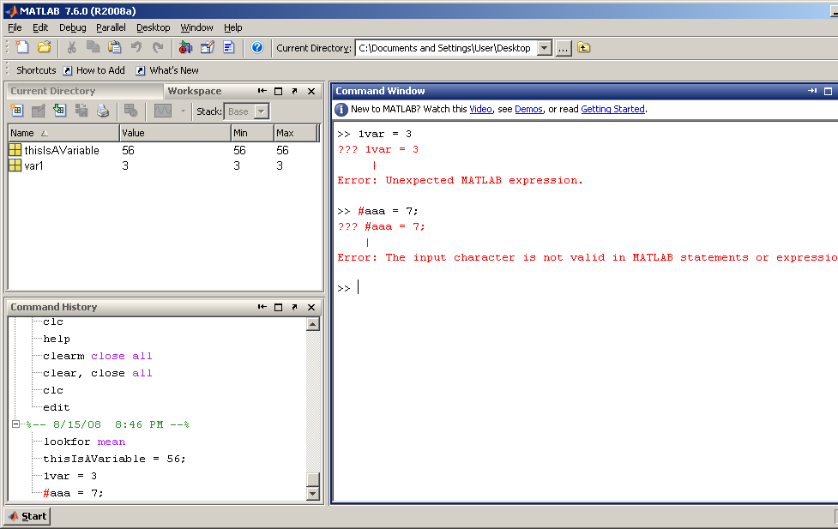

Slide 38
Special Values/Variables
pi: π value up to 15 significant digits
i, j: sqrt(-1)
Inf: infinity (such as division by 0)
NaN: Not-a-Number (division of zero by zero)
clock: current date and time in the form of a 6-element row vector containing the year, month, day, hour, minute, and second
date: current date as a string such as 16-Feb-2004
eps: epsilon is the smallest difference between two numbers
ans: stores the result of an expression

Slide 39
Vectors
Some useful commands:
x = start:end | create row vector x starting with start, counting by one, ending at end
x = start:increment:end | create row vector x starting with start, counting by increment, ending at or before end
linspace(start,end,number) | create row vector x starting with start, ending at end, having number elements
length(x) | returns the length of vector x
y = x’ | transpose of vector x
dot (x, y) | returns the scalar dot product of the vector x and y.

Slide 40
Examples-Vectors
Real Scalars
>> x = 5
x = 5
Row Vector (1 x 3)
>> x = [ 1 2 3 ]
x =
1 2 3
Column Vector ( 3 x 1)
>> x = [ 1 ; 2 ; 3 ]; %”;” suppresses output
>> x
x =
1
2
3
Note: Variable Names are case sensitive

Slide 41
Matrix Variables
Matrix variables are initialized similar to single variables.
The values in a matrix variable is defined in square brackets.
Example:
  aaa = [1,2,3,4];
  bbb = [1;2;3;4];

Slide 42
Row Matrix
To create a row matrix, use the comma to separate the values.
Example:
  rowMatrix = [1,2,3,4,5];

Slide 43
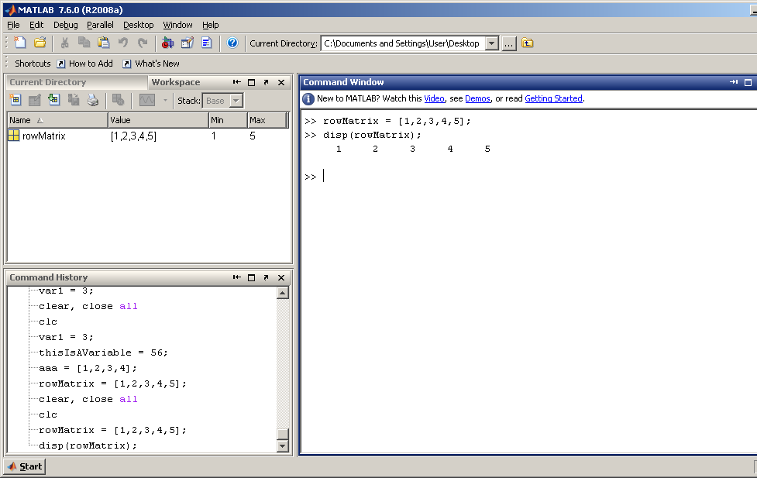
Example

Slide 44
Rows and columns are always numbered starting at 1
Matlab matrices are of various types to hold different kinds of data (usually floats or integers)
A single number is really a 1 x 1 matrix in Matlab!
Matlab variables are not given a type, and do not need to be declared
Any matrix can be assigned to any variable

Slide 45
Try It Yourself
Create a row matrix named var1 with the values of 1, 3, 5 in it.
Create a row matrix named mat1 with the values of 10, 20, 30, 40, 50, 60 in it.
Create a row matrix named var2 with the values of 1, 3, 5, 6, 8, 10, 11 in it.

Slide 46
Column Matrix
To create a column matrix, use the semicolon to separate the values.
Example:
  colMatrix = [1;2;3;4;5];

Slide 47
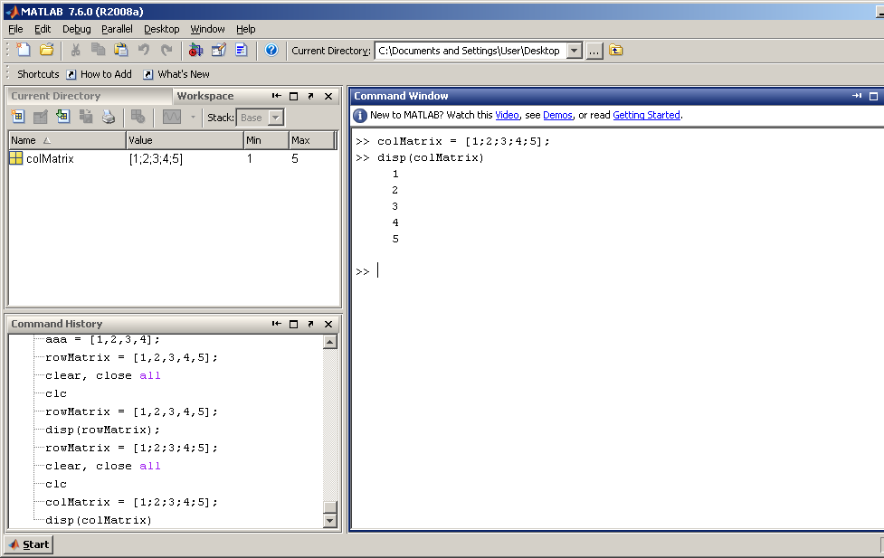
Example

Slide 48
Try It Yourself
Clear and close all variables, and clear console.
Create a column matrix named col1 with the values of 2, 6, 9 in it.
Create a column matrix named mat3 with the values of 15, 23, 37, 48, 59, 61 in it.
Create a column matrix named colMatrix with the values of 1, 3, 5, 6, 8, 10, 11 in it.

Slide 49
Regular Matrix
To create a regular matrix, use the comma to separate each value in a row, and a semicolon to enter the value for a new row.
Example:
  mat1 = [1,2,3;4,5,6;7,8,9];

Slide 50
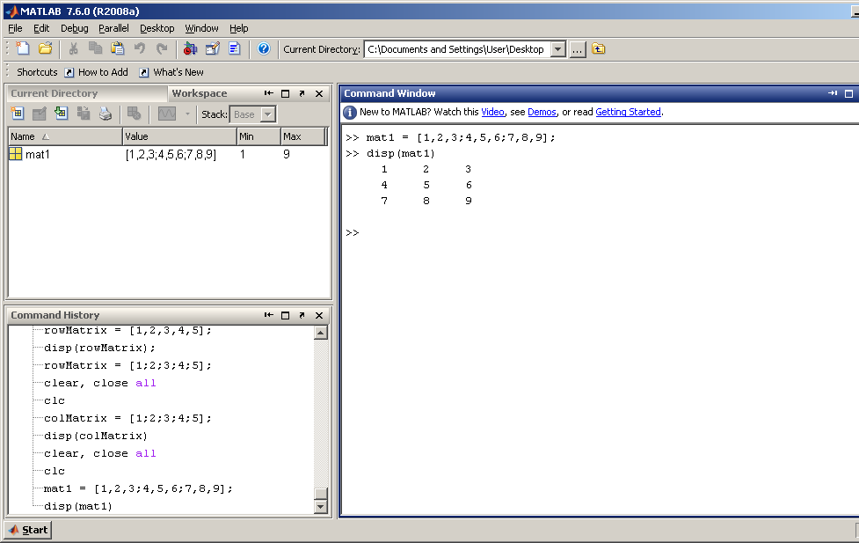
Example

Slide 51
Building matrices with [ ]:
A = [2 7 4]
A = [2; 7; 4]
A = [2 7 4; 3 8 9]
B = [ A A ]
2
7
4
2
7
4
2
7
4
3
8
9
?
2
7
4
2
7
4
3
8
9
3
8
9

Slide 52
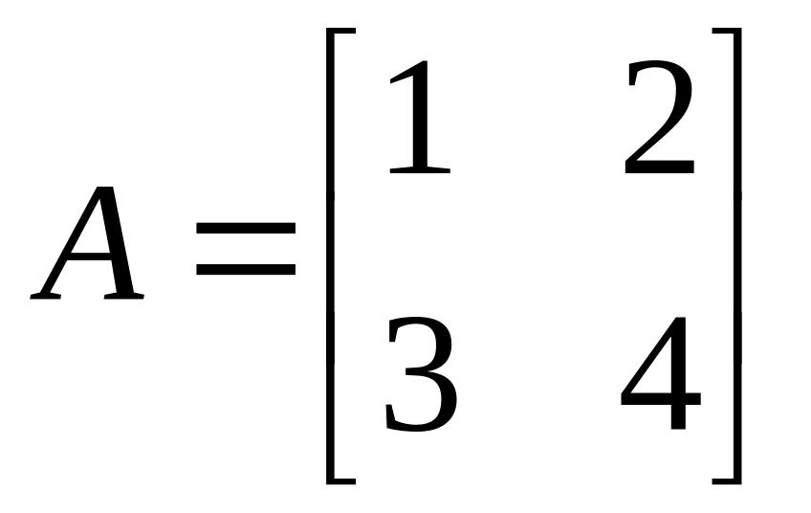
Try It Yourself
Create this matrix:

Slide 53
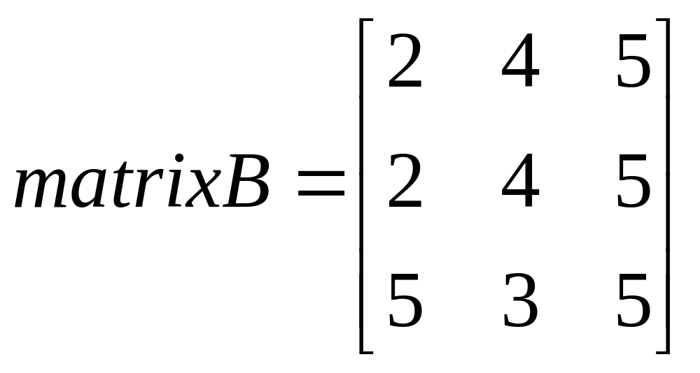
Try It Yourself
Create this matrix:

Slide 54
Accessing Matrix Values
To access a specific value inside a matrix, use this command:
matrixName(rowNumber, colNumber)
Example: to access a value inside row 3 and column 2.
  matrixName(3,2)

Slide 55
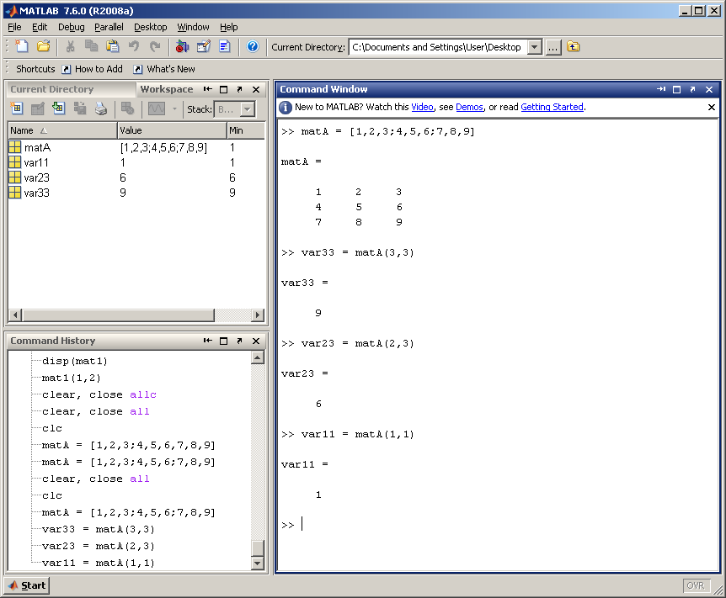

Slide 56
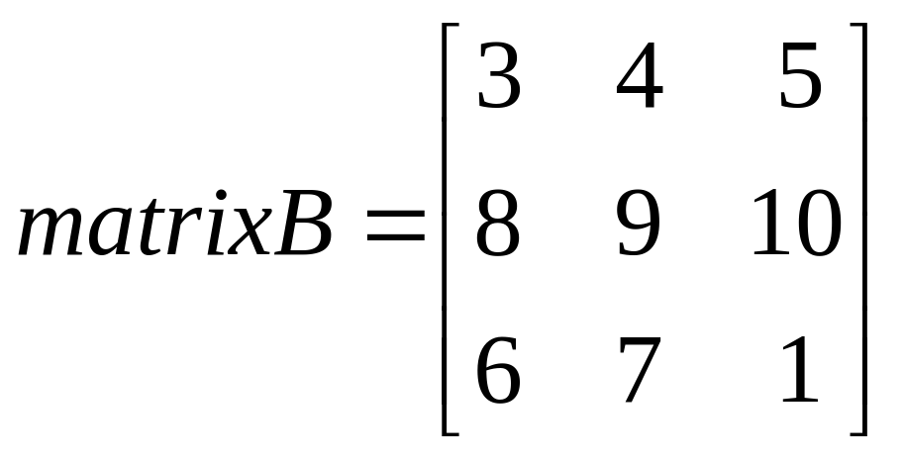
Try It Yourself
Create this matrix:
Try to get values 9, 3 and 1 from the matrix and save it into three variables.

Slide 57
Accessing Whole Columns and Rows
To get a whole column, use this command:
varA = matName(:,colNumber);
To get a whole row, use this command:
varA = matName(rowNumber,:);

Slide 58
Accessing Matrix Elements
>> A= [ 1 2 3 ; 4 5 6 ; 7 8 9];
>> x = A ( 1, 3 ) %A(<row>,<column>)
  x =
    3
>> y = A ( 2 , : ) % selects the 2nd row
  y =
    4 5 6
>> z = A ( 1:2 , 1:3 ) % selects sub-matrix
  z =
    1 2 3
    4 5 6

Slide 59
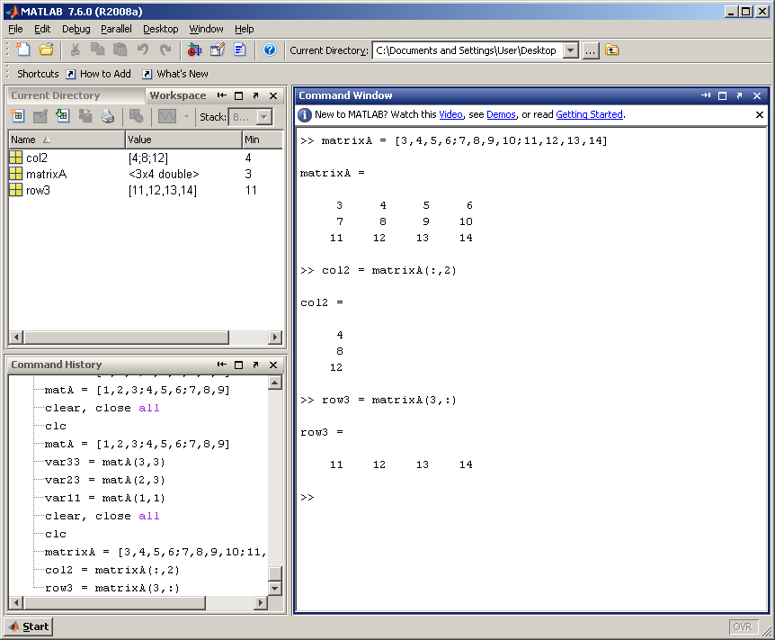
Example

Slide 60
Try it Yourself
Create this matrix:
Get all the values from row 3 and save it into a new variable.
Get all the values from column 1 and save it into a new variable.

Slide 61
Creating a Matrix of Zeros
To create a matrix of zeros, use the zeros command.
Example: create a 6 X 5 matrix of zeros.
zeros(6,5)

Slide 62
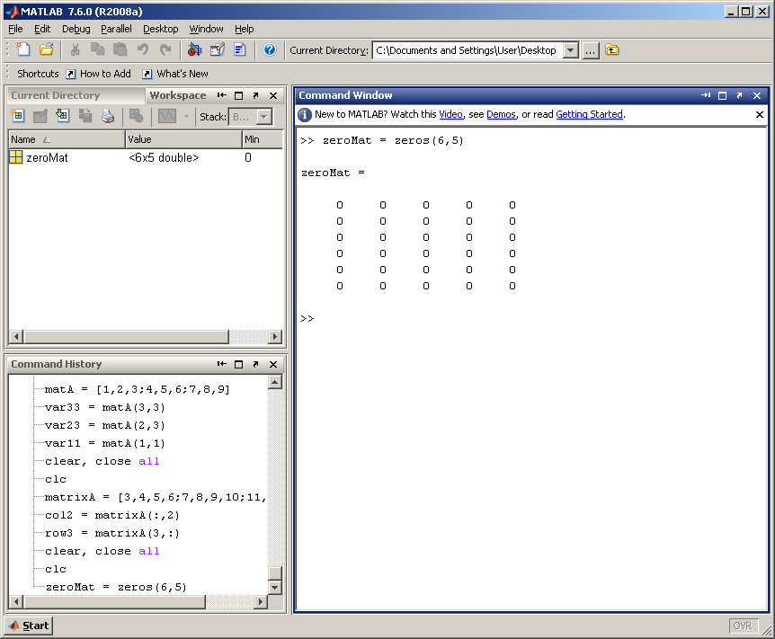
Example

Slide 63
Creating a Matrix of Ones
To create a matrix of ones, use the ones command.
Example: create a 5 X 3 matrix of ones.
ones(5,3)

Slide 64
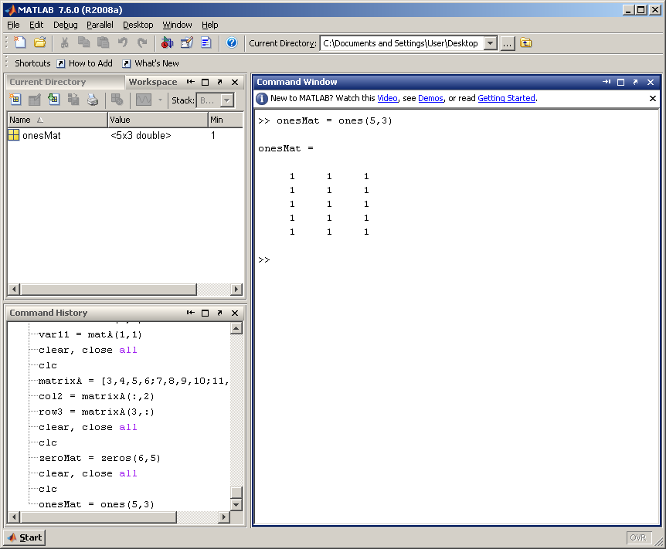
Example

Slide 65
Creating a Matrix of Random Numbers
To create a matrix of random numbers, use the rand command.
Example: create a 4 X 4 matrix of random numbers.
rand(4,4)

Slide 66
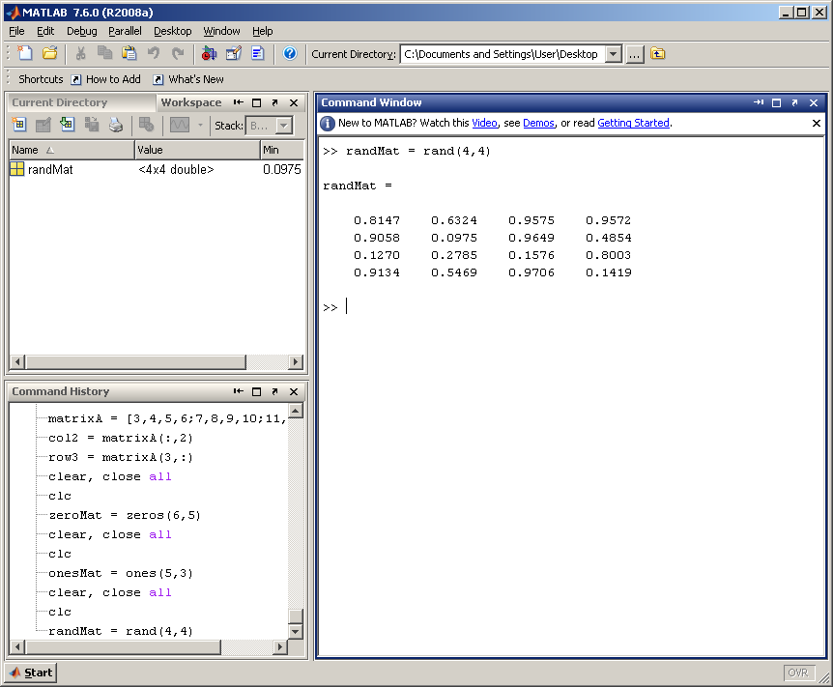
Example

Slide 67
>> B = [ 1 2 ; 8 9 ]
ans =
1 2
8 9
>> ones(2,2) % generates an all ones 2 x 2 matrix
ans =
1 1
1 1
>> zeros(2,3) % generates an all zero 2 x 3 matrix
ans =
0 0 0
0 0 0
>> rand(3,3) % generates a random 3 x 3 matrix
ans =
0.4447 0.9218 0.4057
0.6154 0.7382 0.9355
0.7919 0.1763 0.9169
>> eye(2) % generates the 2 x 2 identity matrix
ans =
1 0
0 1

Slide 68
Getting the Size of the Matrix
To get the size of the matrix, use the size command.
Example: to get the size of matrix aaa.
[numRow, numCol] = size(aaa);

Slide 69
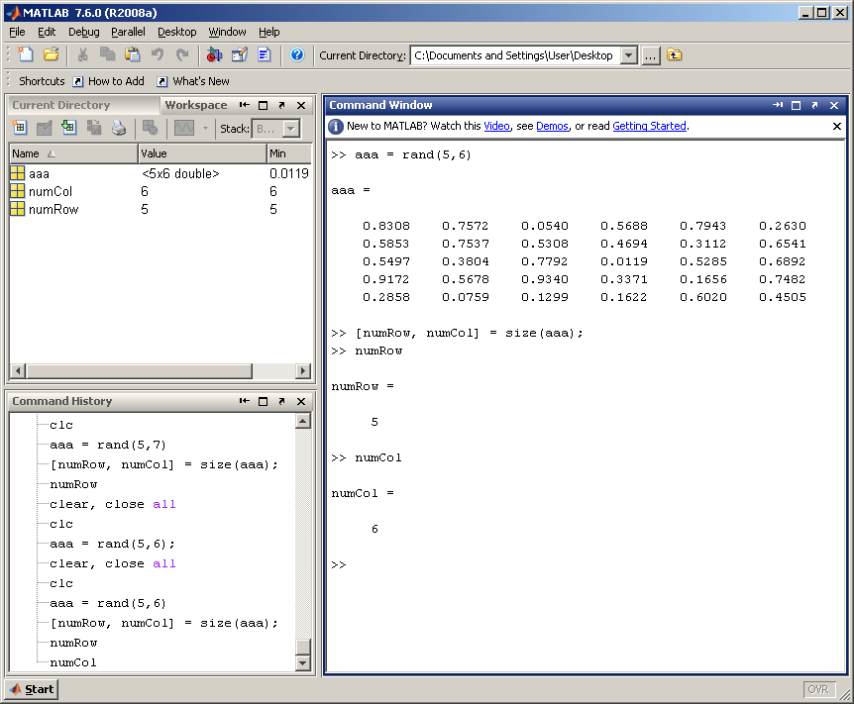
Example

Slide 70
Concatenating, Appending, …
>> R = [ 1 2 3 ] ;
>> S = [ 10 20 30 ] ;
>> T = [ R S ]
  T =
  1 2 3 10 20 30
>> Q = [ R ; S ]
  Q =
  1 2 3
  10 20 30
>> Q ( 3, 3 ) = 100
  Q =
  1 2 3
  10 20 30
  0 0 100

Slide 71
Some Useful Functions
  Some useful math functions:
  sin(x), cos(x), tan(x), atan(x), exp(x), log(x), log10(x), sqrt(x)
  >> t = [ 0 : 0.01 : 10 ];
  >> x = sin ( 2 * pi * t );
  Some useful matrix and vector functions:
  >> size (A)
  ans =
  3 3
  >> length ( t )
  ans =
  1001

Slide 72
Finding the Maximum Value
To find the maximum value for a matrix, use the max function.
Example: find the maximum value in matrix aaa.
maxVal = max(aaa);

Slide 73
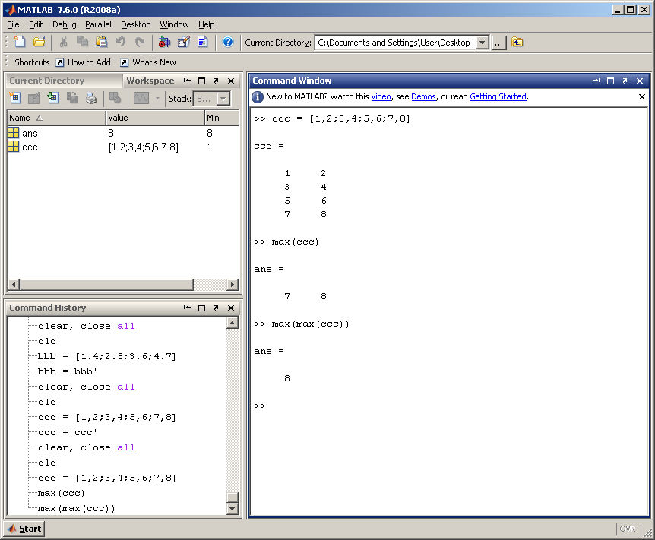
Example
Max finds the
maximum value
in each column
When it is run again
on the result, it
returns the single-largest
value in the matrix.

Slide 74
Finding the Minimum Value
To find the minimum value for a matrix, use the min function.
Example: find the minimum value in matrix aaa.
minVal = min(aaa);

Slide 75
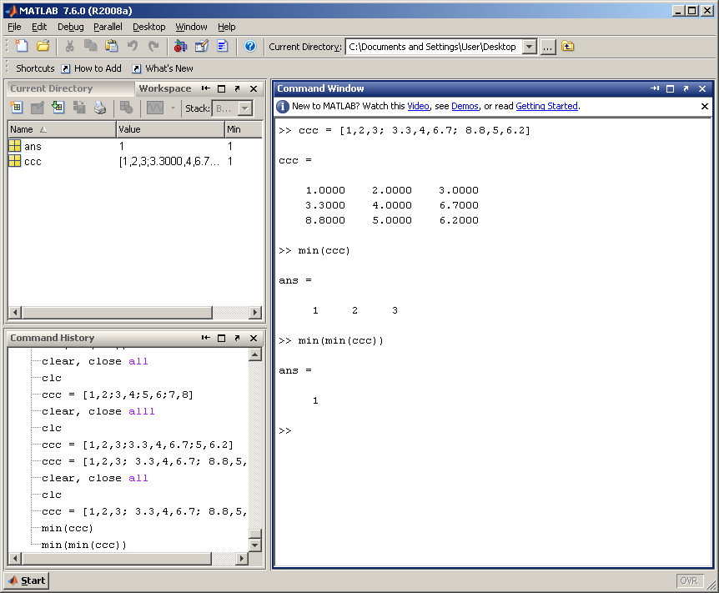
Example
Min finds the
minimum value
in each column
When it is run again
on the result, it
returns the minimum
value in the matrix.

Slide 76
More Operators and Functions
For vectors, SUM(X) is the sum of the elements of X. For matrices, SUM(X) is a row vector with the sum over each column.
>> sum ( A )
ans =
12 15 18
>> sum ( ans ) % equivalent to sum(sum(A))
ans =
45
>> A’ % equivalent to transpose(A)
ans =
    1 4 7
    2 5 8
    3 6 9
>> diag(A)
ans =
    1
    5
    9

Slide 77
At a glance……..
Initializing with Built-in Functions
zeros(n), >> a = zeros(2);
zeros(n,m) >> b = zeros(2, 3);
zeros(size(arr)) >> c = [1, 2; 3, 4];
ones(n) >> d = zeros(size(c));
ones(n,m)
ones(size(arr))
eye(n)
eye(n,m)
length(arr)
size(arr)
magic(m)
pascal(m)

Slide 78
Some Built-in functions
mean(A):mean value of a vector
max(A), min (A): maximum and minimum.
sum(A): summation.
sort(A): sorted vector
median(A): median value
std(A): standard deviation.
det(A) : determinant of a square matrix
dot(a,b): dot product of two vectors
Cross(a,b): cross product of two vectors
Inv(A): Inverse of a matrix A

Slide 79
Matrices
more commands
Transpose | B = A’
Identity Matrix | eye(n) ➔ returns an n x n identity matrix eye(m,n) ➔ returns an m x n matrix with ones on the main diagonal and zeros elsewhere.
Addition and subtraction | C = A + B C = A – B
Scalar Multiplication | B = αA, where α is a scalar.
Matrix Multiplication | C = A*B
Matrix Inverse | B = inv(A), A must be a square matrix in this case. rank (A) ➔ returns the rank of the matrix A.
Matrix Powers | B = A.^2 ➔ squares each element in the matrix C = A * A ➔ computes A*A, and A must be a square matrix.
Determinant | det (A), and A must be a square matrix.
A, B, C are matrices, and m, n, α are scalars.

Slide 80
Adding Matrices
To add matrices, use the + operator.
Example: add matrices A and B.
  A + B.
Make sure that the matrices are the same size.

Slide 81
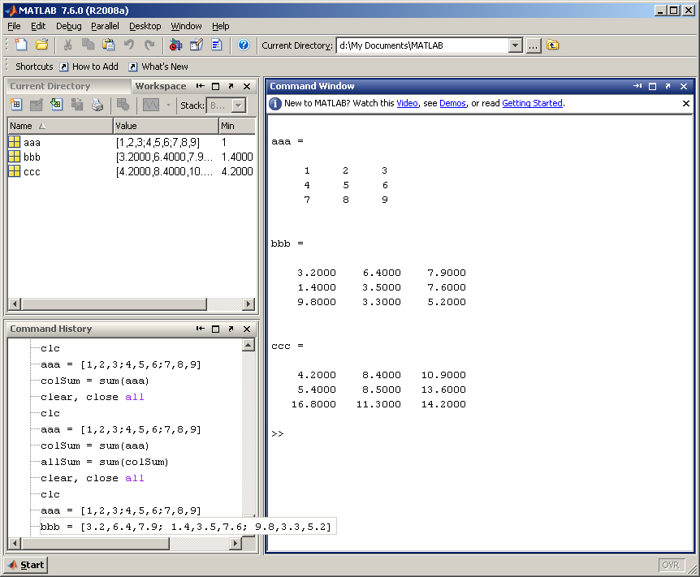
Example

Slide 82
Subtracting Matrices
To subtract matrices, use the - operator.
Example: subtract matrix B from A.
  A - B.
Make sure that the matrices are the same size.

Slide 83
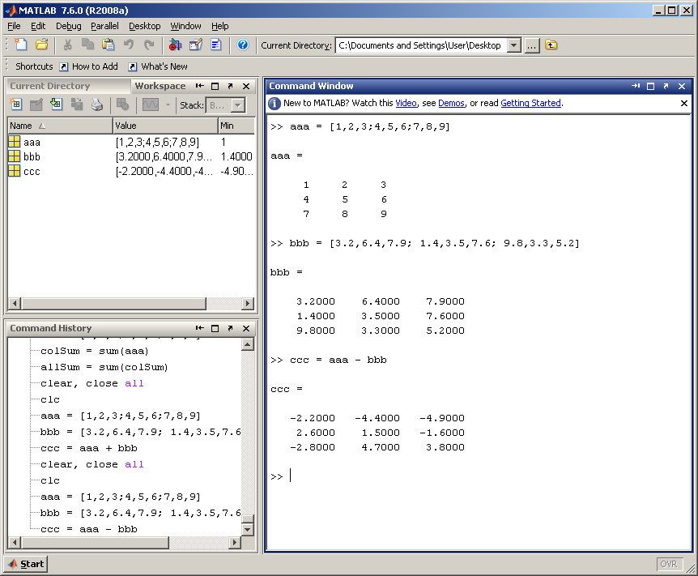
Example

Slide 84
Multiplying Matrices
To multiply matrices, use the .* operator.
Example: multiply matrices A and B.
  A .* B.
Make sure that the matrices are the same size.

Slide 85
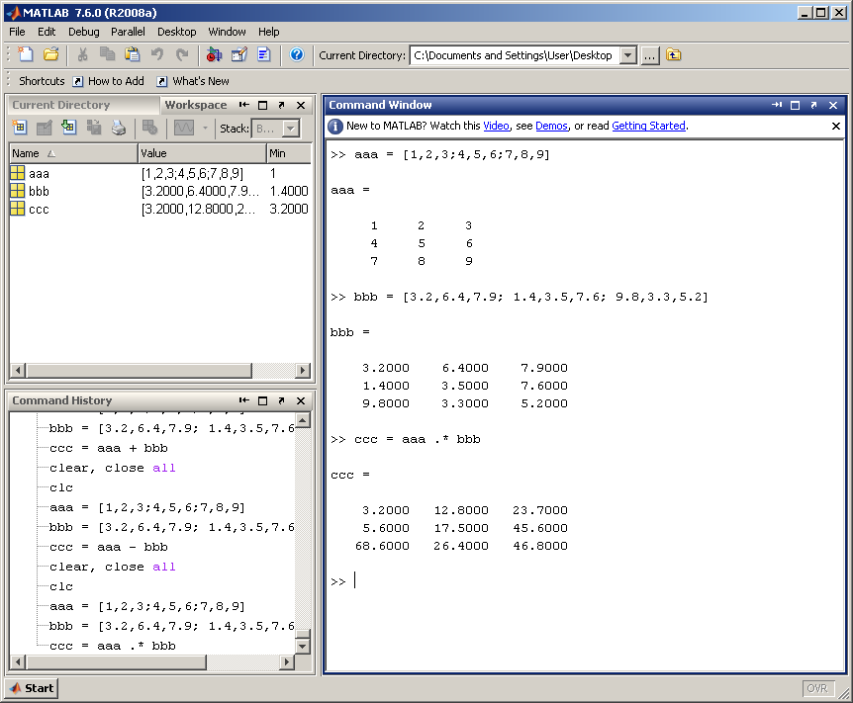
Example

Slide 86
Dividing Matrices
To divide matrices, use the ./ operator.
Example: divide matrices A with B.
  A ./ B.
Make sure that the matrices are the same size.

Slide 87

Example

Slide 88
Operators (relational, logical)
== Equal to
~= Not equal to
< Strictly smaller
> Strictly greater
<= Smaller than or equal to
>= Greater than equal to
& And operator
| Or operator

Slide 89
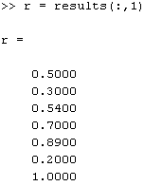
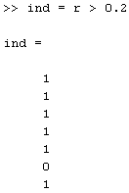

Logical Indexing
  >> r = results(:,1)
  >>ind=r>0.2
  >>r(ind)

Slide 90
Sorting Matrices
To sort a matrix, use the sort command.
Example: sort matrix A in ascending order.
  B = sort(A,’ascend/descend’)
  Default is ascending mode.

Slide 91
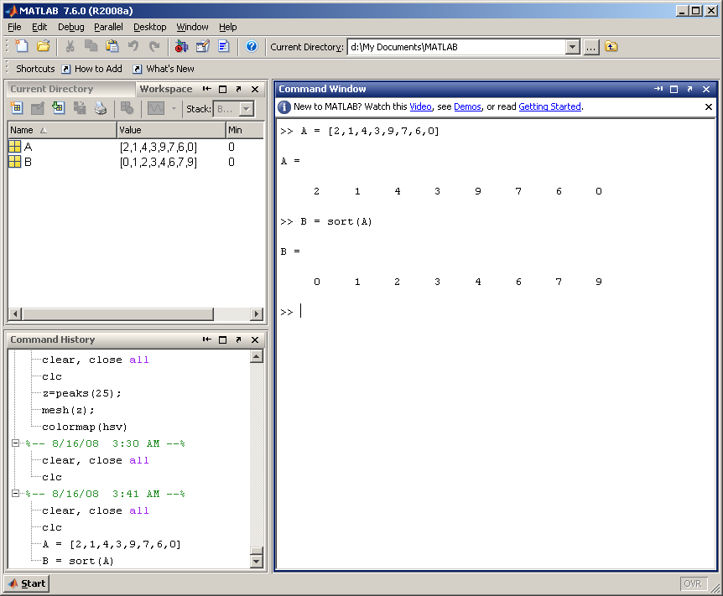
Example: Sorting a Row Matrix

Slide 92
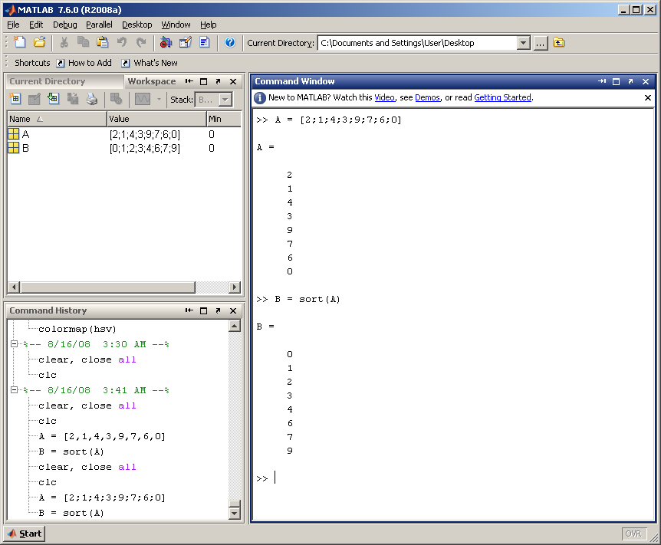
Example: Sorting a Column Matrix

Slide 93
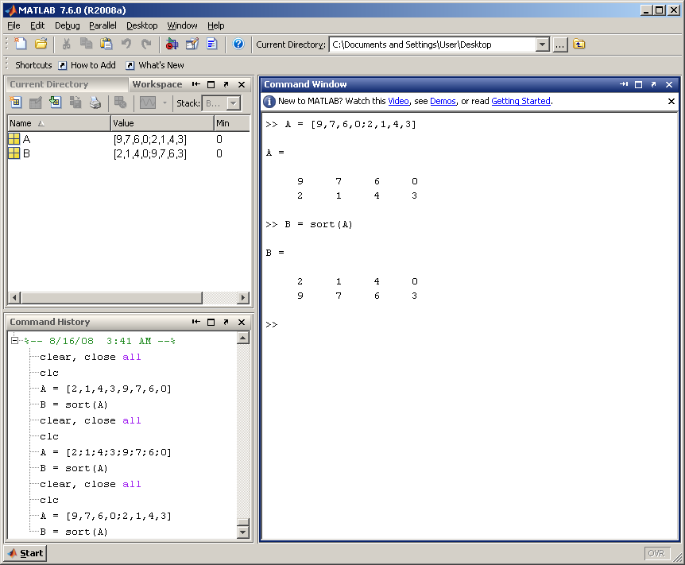
Example: Sorting a Regular Matrix

Slide 94
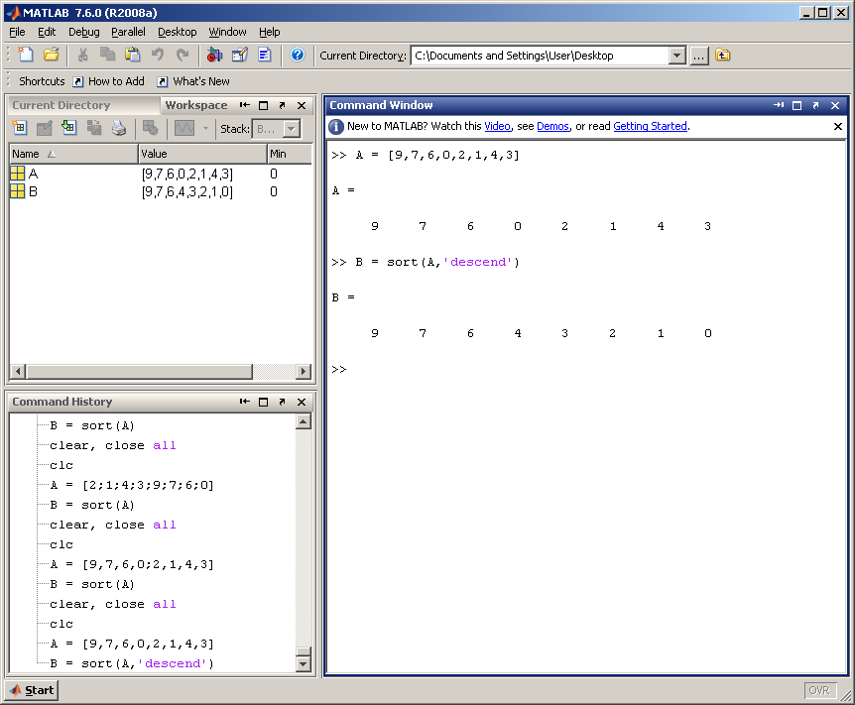
Example: Sorting a Row Matrix in Descend Mode

Slide 95
Flipping a Matrix
A matrix can be flipped using the flipud or fliplr commands.
Command flipud flips the matrix in UP/DOWN direction.
Command fliplr flips the matrix in LEFT/RIGHT direction.

Slide 96

Example: flipud

Slide 97

Example: fliplr

Slide 98
Term by Term vs Matrix Operations
>> B = [ 1 2 ; 3 4 ] ;
B =
1 2
3 4
>> C = B * B % or equivalent B^2
C =
7 10
15 22
>> D = B .* B % or B.^2 The Dot denotes term by term operations
D =
1 4
9 16

Slide 99
Operators (Element by Element)
.* element-by-element multiplication
./ element-by-element division
.^ element-by-element power

Slide 100
Initializing with Keyboard Input
The input function displays a prompt string in the Command Window and then waits for the user to respond.
my_val = input( ‘Enter an input value: ’ );
in1 = input( ‘Enter data: ’ );
in2 = input( ‘Enter data: ’ ,`s`);

Slide 101
Strings
MATLAB also can accept and manipulate string variables.
A string is defined by enclosing it in single quotes.
Example: aString = ‘Hello World!’

Slide 102
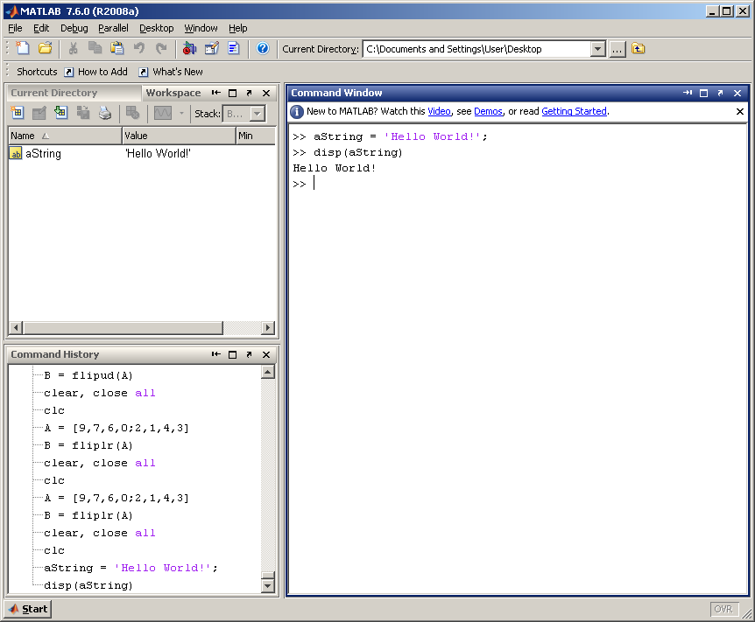
Example: Initializing a String

Slide 103
Converting a String to Lowercase
To convert a string to lowercase, use the lower command.
Example: change string in matrix A to lowercase:
  B = lower(A)

Slide 104
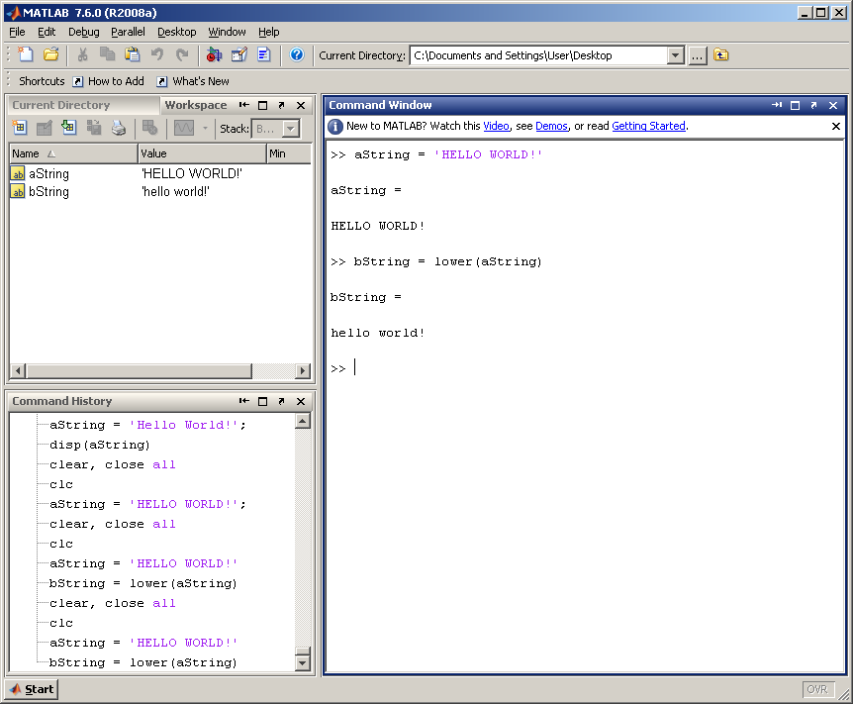
Example: Change String to Lowercase

Slide 105
Converting a String to Uppercase
To convert a string to uppercase, use the upper command.
Example: change string in matrix A to uppercase:
  B = upper(A)

Slide 106
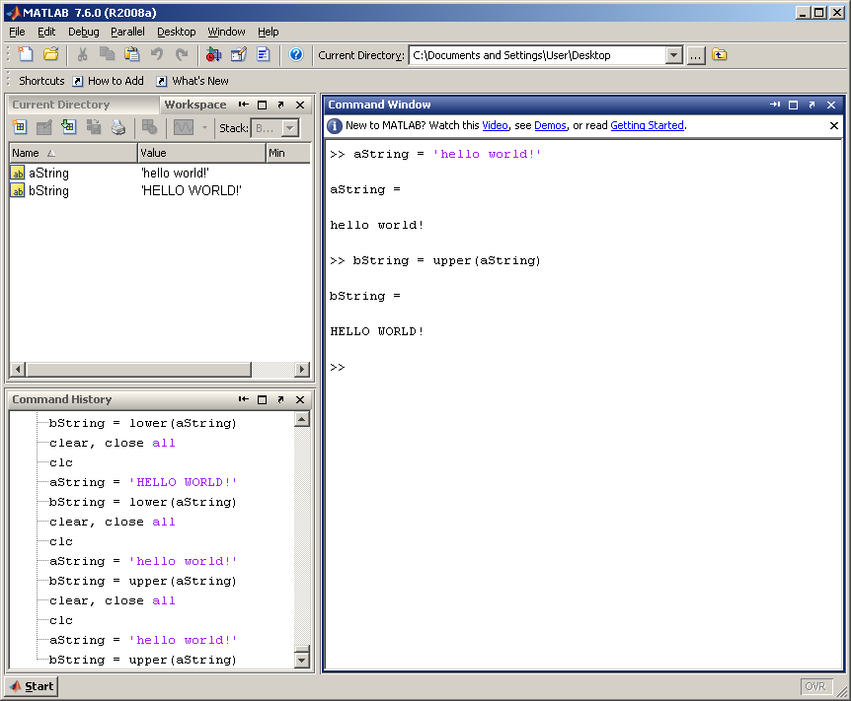
Example: Change String to Uppercase

Slide 107
Concatenate Strings
Concatenating string means merging two or more strings together.
To concatenate strings, use the strcat command.
Example: to concatenate str1 and str2:
  newStr = strcat(str1,str2)

Slide 108
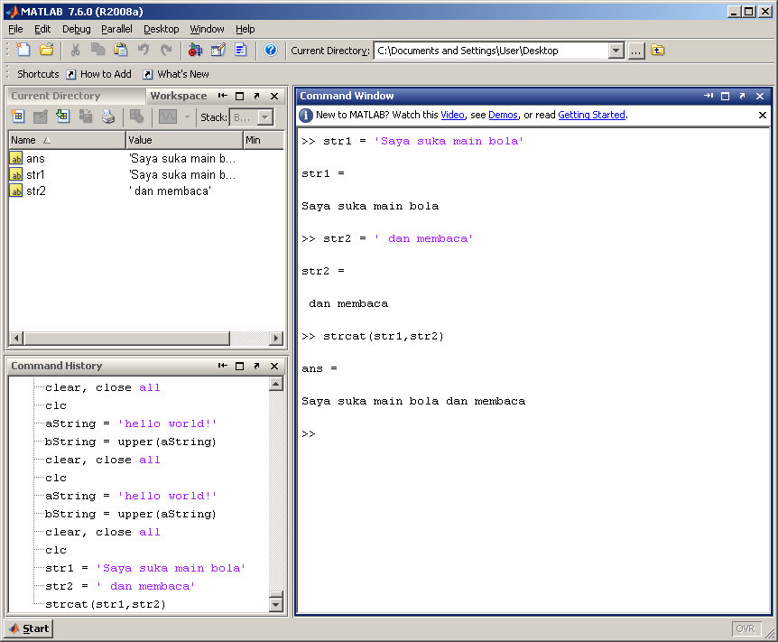
Example: Concatenate String

Slide 109
Replace String
To replace part of the string with a new value, use the strrep command.
Example: replace the word ‘lama’ with the word ‘baru’ in the string str1.
  strrep(str1,’lama’,’baru’)

Slide 110
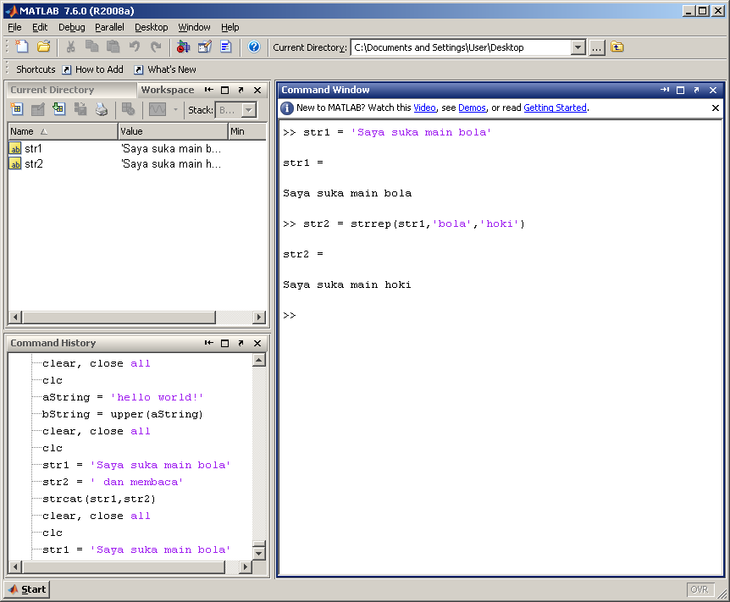
Example: Replace String

Slide 111
The num2str() and int2str() functions
  >> d = [ num2str(16) '-Feb-' num2str(2004) ];
  >> disp(d)
  16-Feb-2004
  >> x = 23.11;
  >> disp( [ 'answer = ' num2str(x) ] )
  answer = 23.11
  >> disp( [ 'answer = ' int2str(x) ] )
  answer = 23

Slide 112
MATLAB BASICS
The fprintf( format, data ) function
  %d integer
  %f floating point format
  %e exponential format
  %g either floating point or exponential format, whichever is shorter
  \n new line character
  \t tab character

Slide 113
MATLAB BASICS
  >> fprintf( 'Result is %d', 3 )
  Result is 3
  >> fprintf( 'Area of a circle with radius %d is %f', 3, pi*3^2 )
  Area of a circle with radius 3 is 28.274334
  >> x = 5;
  >> fprintf( 'x = %3d', x )
  x = 5
  >> x = pi;
  >> fprintf( 'x = %0.2f', x )
  x = 3.14
  >> fprintf( 'x = %6.2f', x )
  x = 3.14
  >> fprintf( 'x = %d\ny = %d\n', 3, 13 )
  x = 3
  y = 13

Slide 114
MATLAB BASICS
Data files
save filename var1 var2 …
  >> save myfile.mat x y → binary
  >> save myfile.dat x –ascii → ascii
load filename
  >> load myfile.mat → binary
  >> load myfile.dat –ascii → ascii

Slide 115
Loading & saving Excel files
% Create an Excel file named myExample.xlsx.
values = {1, 2, 3 ; 4, 5, 'x' ; 7, 8, 9};
headers = {'First','Second','Third'};
xlswrite('myExample.xlsx',[headers; values]);
% Read numeric data from the first worksheet
filename = 'myExample.xlsx';
A = xlsread(filename)

Slide 116
Built-in MATLAB Functions
result = function_name( input );
  abs, sign
  log, log10, log2
  Exp
  sqrt, std
  sin, cos, tan
  asin, acos, atan
  max, min
  mean, median, mode
  round, floor, ceil, fix
  mod, rem
help elfun → help for elementary math functions

Slide 117
Passing a vector to a function like sum, mean, std will calculate the property within the vector
  >> sum([1,2,3,4,5])
  = 15
  >> mean([1,2,3,4,5])
  = 3

Slide 118
Cell
C = cell(2,2); % create a 2 by 2 cell
C{1,1} = rand(3);% put a 3x3 random matrix in the 1st box
C{1,2} = char('john','raj');% put a string array in the 2nd box
C{2,1} = 3;% put a number in the 3rd box
C{2,2} = cell(3,3);% put a 3x3 cell in the 4th box

Slide 119
Meshgrid
[X,Y] = meshgrid(1:3,10:14)
X =
1 2 3
1 2 3
1 2 3
1 2 3
1 2 3

Slide 120
Some important built-in functions
meshgrid -
[X,Y] = meshgrid(1:3,10:14)
X =
1 2 3
1 2 3
1 2 3
1 2 3
1 2 3
Y =
10 10 10
11 11 11
12 12 12
13 13 13
14 14 14

Slide 121
Repmat -Repeat copies of array
A = diag([100 200 300])
B = repmat(A,2)
B =
100 0 0 100 0 0
0 200 0 0 200 0
0 0 300 0 0 300
100 0 0 100 0 0
0 200 0 0 200 0
0 0 300 0 0 300
A =
100 0 0
0 200 0
0 0 300

Slide 122
Conditional Operators

Slide 123
If…else Operator
The if…else operator tests a condition.
If the condition is true, then execute the if block.
If the condition is false, execute the else block.

Slide 124
If…else Operator
if (condition)
% if block
else
% else block
end
% conditions that can be tested
% == : is equal to
% ~= : is not equal to
% > : larger than
% >= : larger than or equal
% <= : less than or equal
% < : less than

Slide 125
Example
clear, close all
clc
aaa = rand(1,100);
bbb = 1:1:100
color = 1;
if (color == 1)
% if block
figure, plot(bbb,aaa,':r');
else
% else block
figure, plot(bbb,aaa,'b');
end

Slide 126
Example
clear, close all
clc
x = 3;
if (x > 5)
disp('The number is more than 5.')
elseif (x == 5)
disp('The number is equal to 5.')
else
disp('The number is less than 5.')
end

Slide 127
For loop
Used to repeat a set of statements multiple times.
The for loop format is:
  for(startingvalue:increment:endingvalue)

Slide 128
For Loop
clear, close all
clc
% i is the value of the counter
for i = initial_value:increment:ending_value
% statements in this block will be executed until i
% reaches the ending_value
end

Slide 129
Example: Display value inside for loop
clear, close all
clc
for i = 1:1:15
st1 = strcat('The value of i inside the loop is: ',int2str(i));
disp(st1)
end

Slide 130
Example: Display “Hello World” 10 Times
st1 = 'Hello World!';
for i = 1:1:10
disp(st1)
end

Slide 131
Example: Check Value Inside Matrix
clear, close all
clc
matA = [1.4,4.2,6.7,7.0; 5.5,6.7,8.9,3.0; 0.6,6.12,5.44,8.94]
[row,col] = size(matA)
for i = 1:1:row
for j = 1:1:col
currNo = matA(i,j);
st1 = strcat('The value being tested is: ', num2str(currNo),'.');
disp(st1)
if (currNo > 3)
disp('The current value is larger than 3.')
else
disp('The current value is less or equal than 3.')
end
end
end

Slide 132
While loop
Used to repeat a set of statements while the tested condition is true.
The while loop format is:
  while(condition)
The tested condition is the same as if…else

Slide 133
Conditions that can be tested
% conditions that can be tested
% == : is equal to
% ~= : is not equal to
% > : larger than
% >= : larger than or equal
% <= : less than or equal
% < : less than

Slide 134
Example: Display value inside for loop
clear, close all
clc
counter = 1;
while(counter <= 15)
st1 = strcat('The value of i inside the loop is: ',int2str(counter));
disp(st1)
counter = counter + 1;
end

Slide 135
Example: Display “Hello World” 10 Times
clear, close all
clc
st1 = 'Hello World!';
counter = 1;
while(counter <= 10)
disp(st1)
counter = counter + 1;
end

Slide 136
Functions

Slide 137
Functions
A complex program may be divided into several functions.
These functions can improve readability of the code, as well as promote re-usability of the code.
Each function must be saved into a different file, with the filename similar to the function.

Slide 138
Function
The format of a function is:
  function returnValue = fcnName(inputValue)

Slide 139
Example
function hasil = addFcn(number1, number2)
hasil = number1 + number2;
% to call this function, call the fcn name
% using your own parameters.
% e.g. c = addFcn(3,4)
% e.g. c = addFcn(a,b)

Slide 140
Example: Using Functions
clear, close all
clc
number1 = 4;
number2 = 5;
selection = 1;
if selection == 1
hasil = addFcn(number1,number2);
elseif selection == 2
hasil = subFcn(number1,number2);
elseif selection == 3
hasil = mulFcn(number1,number2);
elseif selection == 4
hasil = divFcn(number1,number2);
else
disp('The selection is invalid.')
end
disp(strcat('The result is:', num2str(hasil)));

Slide 141
addFcn
function hasil = addFcn(number1, number2)
hasil = number1 + number2;

Slide 142
subFcn
function hasil = subFcn(number1, number2)
hasil = number1 - number2;

Slide 143
mulFcn
function hasil = mulFcn(number1, number2)
hasil = number1 * number2;

Slide 144
divFcn
function hasil = divFcn(number1, number2)
hasil = number1 / number2;

Slide 145
Sample Problems

Slide 146
Initializing Variables in Assignment Statements
An assignment statement has the general form
var = expression
Examples:
>> var = 40 * i; >> a2 = [0 1+8];
>> var2 = var / 5; >> b2 = [a2(2) 7 a];
>> array = [1 2 3 4]; >> c2(2,3) = 5;
>> x = 1; y = 2; >> d2 = [1 2];
>> a = [3.4]; >> d2(4) = 4;
>> b = [1.0 2.0 3.0 4.0];
>> c = [1.0; 2.0; 3.0];
>> d = [1, 2, 3; 4, 5, 6]; ‘;’ semicolon suppresses the
>> e = [1, 2, 3 automatic echoing of values but
4, 5, 6]; it slows down the execution.

Slide 147

Problem 1
Write a program that calculates and displays the volume of a sphere when given the radius. The volume calculation must be performed in a function called calcSphereVolume.
The formula for volume is:

Slide 148

Problem 2
Write a program that plots the function:
for values of x = -50 to 50

Slide 149
Problem 3
Generate a 100x50 matrix of random numbers called A.
For each value inside the matrix, if the value is above 0.5, change its value to 1. If it is below 0.5, change its value to zero.
Then, count and display how many ones inside the matrix.

Slide 150
Plot the function e^{-x/3}sin(x) between 0≤x≤4π
Create an x-array of 100 samples between 0 and 4π.
Calculate sin(.) of the x-array
Calculate e^{-x/3} of the x-array
Multiply these two arrays

Slide 151

Basic Task: Plot the function sin(x) between 0≤x≤4π
Create an x-array of 100 samples between 0 and 4π.
Calculate sin(.) of the x-array
Plot the y-array
>>x=linspace(0,4*pi,100);
>>y=sin(x);
>>plot(y)

Slide 152
Plot the function e^{-x/3}sin(x) between 0≤x≤4π
Create an x-array of 100 samples between 0 and 4π.
Calculate sin(.) of the x-array
Calculate e^{-x/3} of the x-array
Multiply the arrays y and y1
>>x=linspace(0,4*pi,100);
>>y=sin(x);
>>y1=exp(-x/3);
>>y2=y*y1;

Slide 153

Plot the function e^{-x/3}sin(x) between 0≤x≤4π
Multiply the arrays y and y1 correctly
Plot the y2-array
>>y2=y.*y1;
>>plot(y2)

Slide 154
Additional References:
http://web.mit.edu/6.003/www/matlab.html
http://web.mit.edu/6.003/www/Labs/matlab_6003.pdf
http://web.mit.edu/6.003/www/Labs/matlab_tut.pdf

Slide 155
The End

